Slide 1
Mobile Price Classification
By: AMALJITH C K

Slide 2
INTRODUCTION
In today's market, mobile phones come in a wide range of prices, each offering different features and specifications. For consumers, selecting a mobile phone that aligns with their budget and requirements can be challenging. To assist consumers in making informed decisions, this project aims to develop a machine learning model that can classify mobile phones into different price ranges based on their features.

Slide 3
Problem Statement
The task is to build a predictive model that can accurately classify mobile phones into predefined price ranges based on various attributes such as battery power, camera features, memory, connectivity options, and more. The dataset provided contains information about several mobile phones, including their specifications and corresponding price ranges.

Slide 4
Dataset Description
We have given two datasets
1)Train Data
2)Test Data
Train data contains information such as
Battery power, Bluetooth, Clock speed, Dual sim, Fast charger, Four G, Int memory, Mobile depth, Number of cores, PC, Px height, Px width, Ram, Screen Height, Screen width, Talk time , Three G, Touch screen, Wifi, Price range.
Test data also contains the same information except Price range

Slide 5
Dataset Description
1)Explore and preprocess the dataset to handle missing values, outliers, and any other data inconsistencies.
2)Perform exploratory data analysis (EDA) to gain insights into the relationships between different features and the target variable (price range).
3)Select appropriate machine learning algorithms for classification and evaluate their performance using suitable metrics.
4)Fine-tune the chosen model to improve its predictive accuracy.
5)Validate the final model using cross-validation techniques to ensure its robustness.
6)Deploy the model for real-time predictions if applicable.

Slide 6
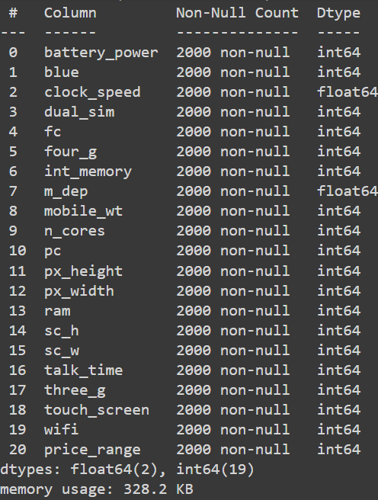
Data information

Slide 7
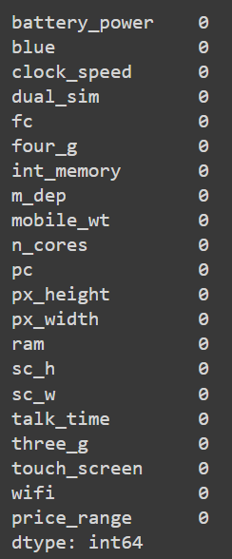
Checking null values
There is no null values in our data

Slide 8
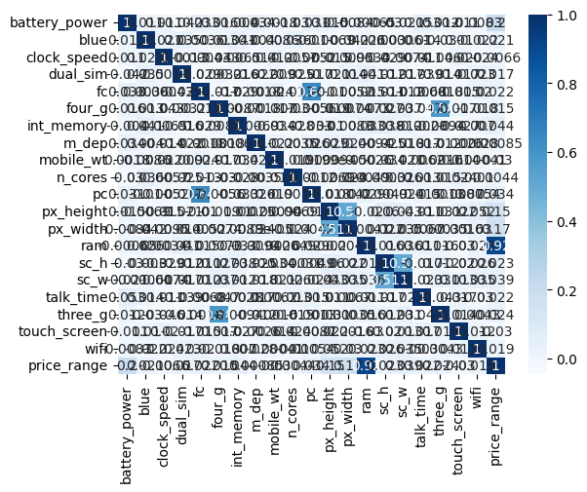
Heatmap Representation

Slide 9
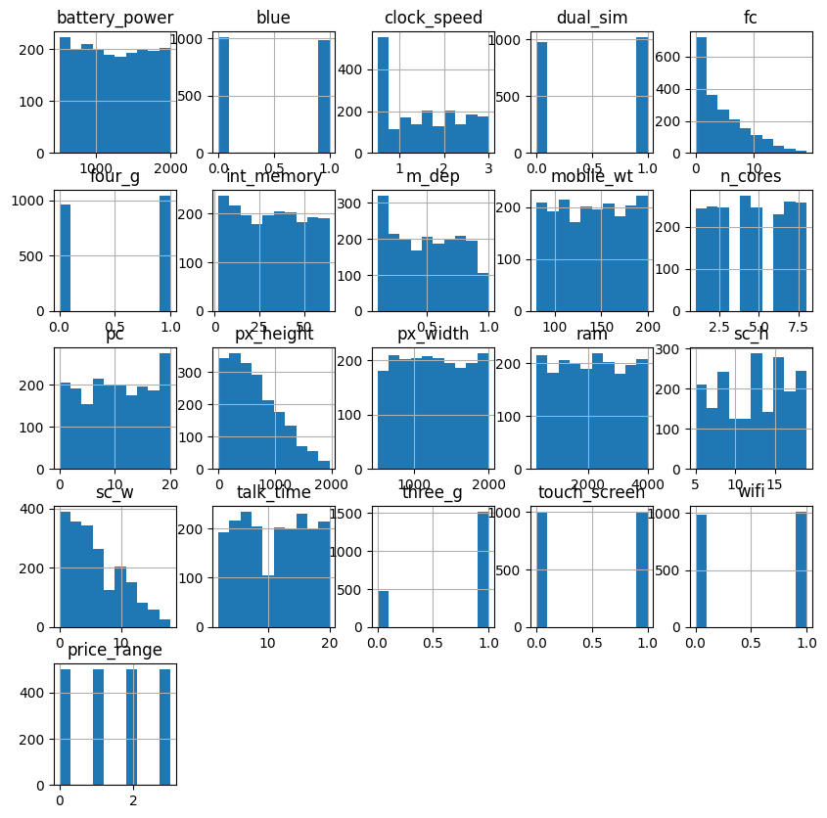
Histogram Representation

Slide 10
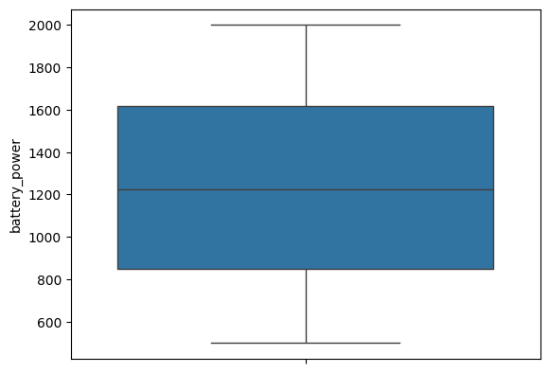
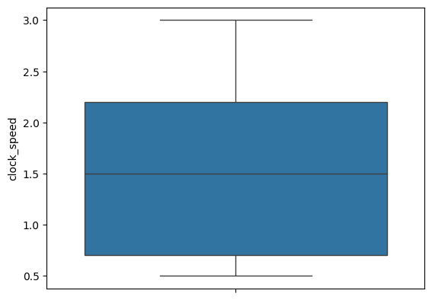
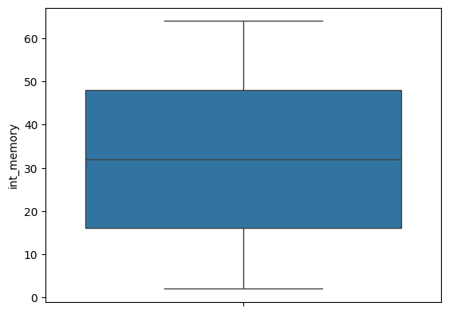
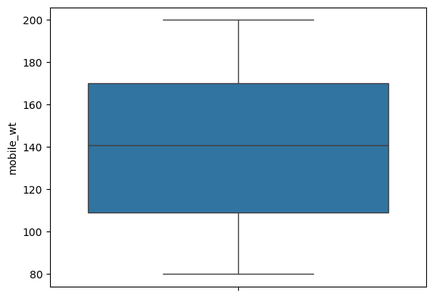
Detect Outliers

Slide 11
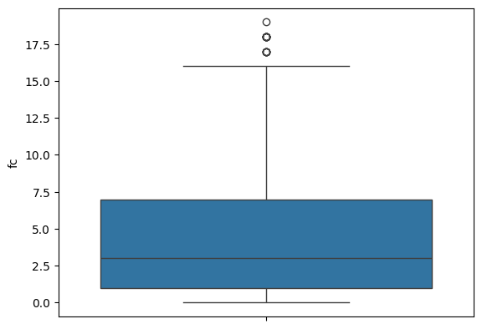
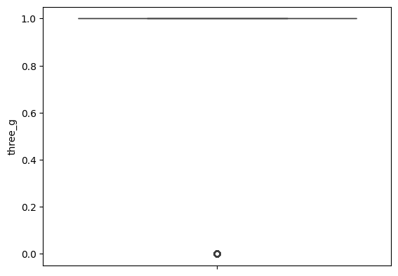
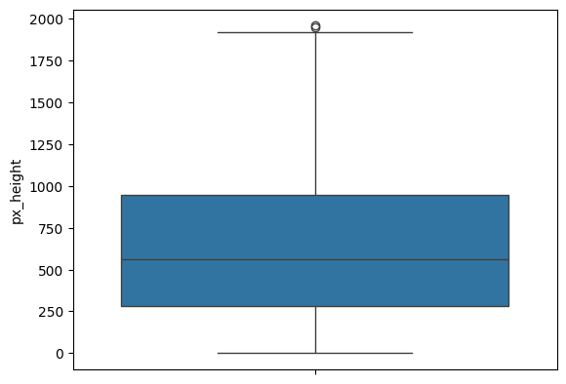
Some Outliers are there in Fast charging, Three G, Px height values.

Slide 12
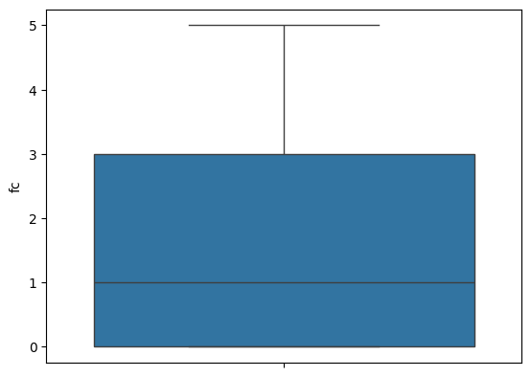
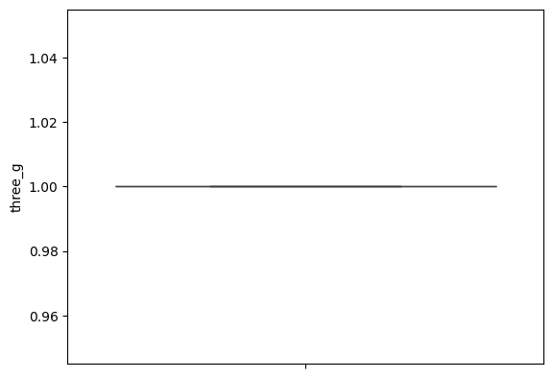
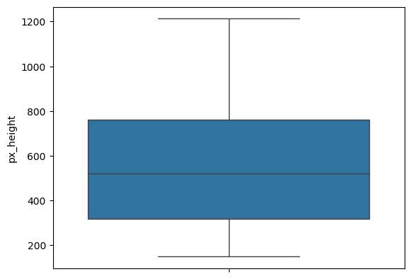
After some treatment the outliers are removed.

Slide 13
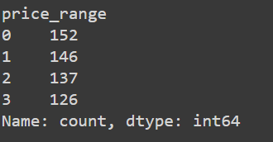
The values from price range are not balanced. So applied RandomUnderSampling

Slide 14
Then assigned values from the data to x and y variable then applied train_test_split.

Slide 15
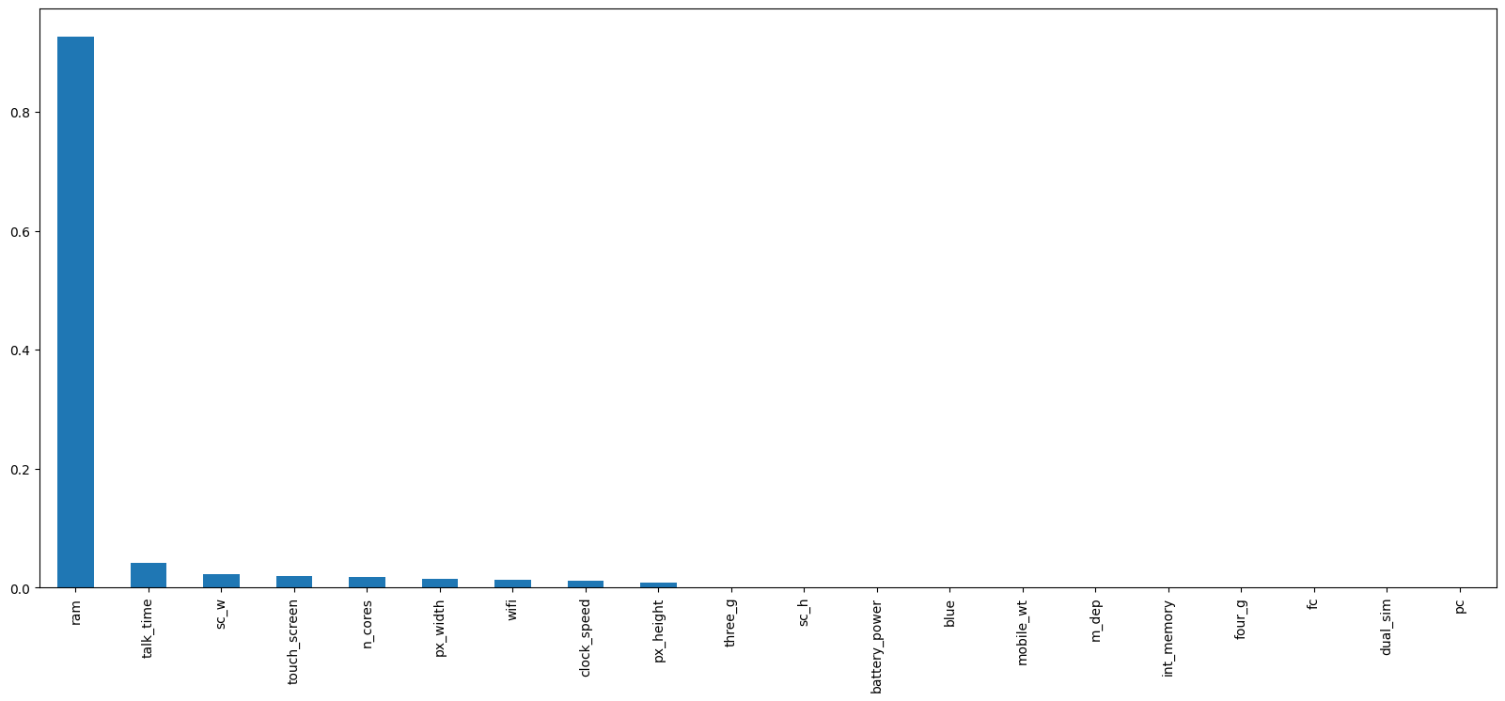
Find the features that has more role to predict the dependent variable or target variable.
Here ram has the crucial role to predict the price range.

Slide 16
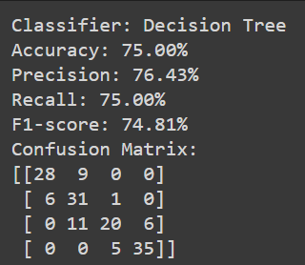
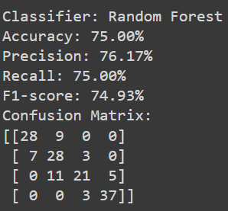
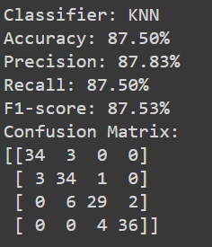
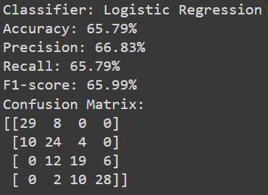
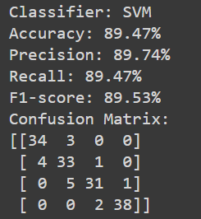
Here we can see SVM has the best Accuracy score, Precision among other classifiers

Slide 17
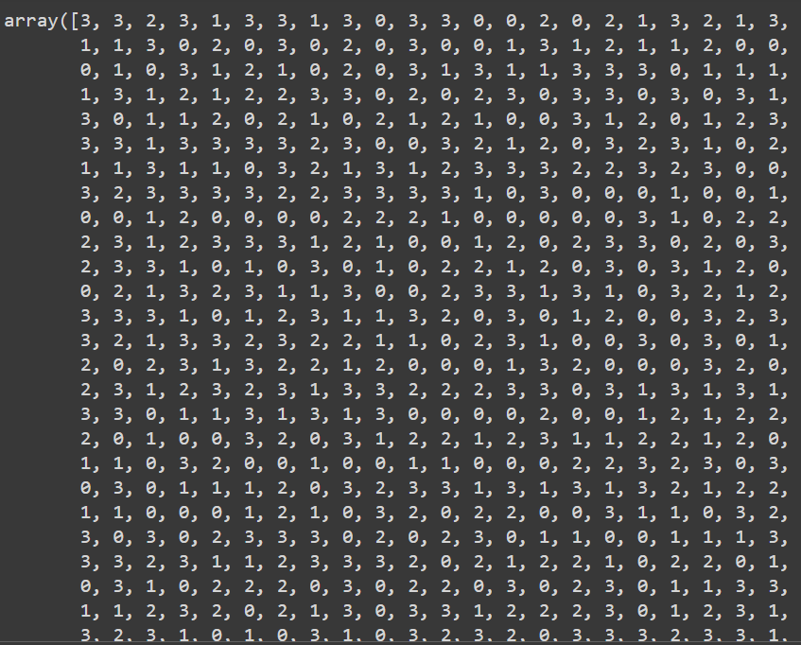
Then using Support Vector Classifier predict the price range of test data

Slide 18
Findings
Many factors influence the price range of a mobile phone.
When the size of Ram is high the price is too high also but other factors has not that much impact on deciding the price range.
A higher RAM size tends to result in a higher price, whereas other factors have less impact on determining the price range.

Slide 19
Conclusion
By successfully developing an accurate classification model, this project aims to empower consumers with a tool that can assist them in making informed decisions while purchasing mobile phones within their budget constraints.
The insights gained from this project could be valuable for manufacturers and retailers in understanding consumer preferences and market trends.

Slide 20
THANK YOU

